Slide 1
Lecture 9
Supply chain for space components

Slide 2
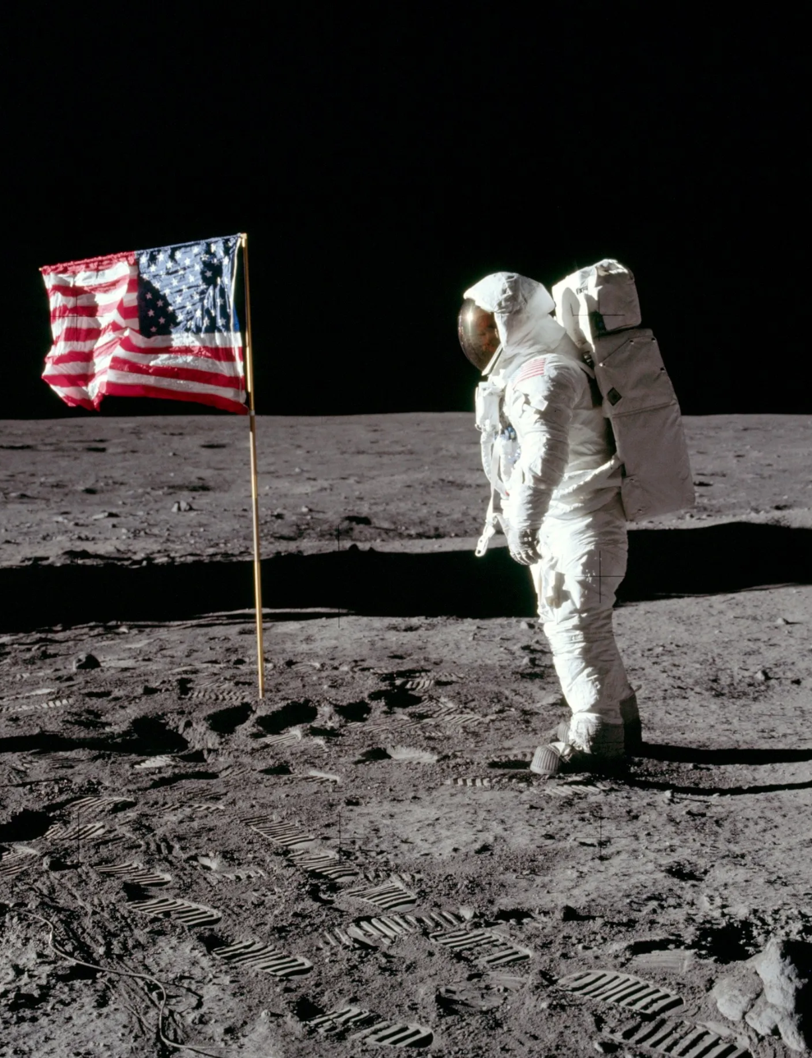
Classical Space: Apollo
Apollo project (1960 - 1973)
- $25.8Bn or $257Bn inflation adjusted
*Some discrepancy in this number (15% - 20% estimated)
- 11 crewed missions, moon landing on fifth mission
- Goal to achieve moon landing and surface exploration
- Additionally, achieve "preeminence in space" for the US
- Source: Apollo by the Numbers
Classical Space is characterized by:
- Defense focus and support solely by national agencies and government.
- Complex, expensive missions with long schedules
- Production of large, monolithic systems
- Focused on reliability as many missions were manned
- Frequent deep space exploration - GEO orbit

Slide 3

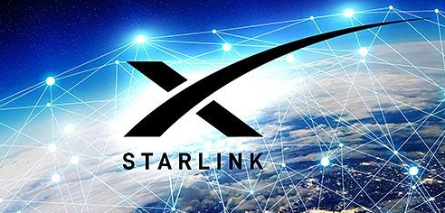
New Space: Starlink
Starlink (2015 - ):
- Goal to bring internet to all
- Frequent launches, more than 9700 satellites launched
- Orbit approx 550km (LEO orbit)
- A large constellation of repeated units
- Launched by Falcon 9, claim of reusability
A new era of space since early 2000s:
- Decentralizing space, space travel for all, many startups offering space-as-a-service.
- Short schedules, frequent launches, short missions
- Constellations like Starlink, composed of SmallSat or CubeSat nodes
- Unmanned, low orbit (LEO orbit)
- Focused on cost and speed

Slide 4
A new way of doing business
To meet future needs, the Department of Defense must increase access to commercial state-of-the-art technology and must facilitate the adoption by its suppliers of business processes characteristic of world class suppliers. In addition, integration of commercial and military development and manufacturing facilitates the development of dual-use processes and products and contributes to an expanded industrial base that is capable of meeting defense needs at lower costs.
~ William Perry, DoD, 1994

Slide 5
Memo key points
1. Curb government control and influence in favour of the free market
I direct the Secretaries of the Military Departments and the Directors of the Defense Agencies to reduce direct Government oversight by substituting process controls and non-government standards…
…encourage contractors to propose non-government standards and industry-wide practices that meet the intent of the military specifications and standards.
2. Preference for Performance and Commercial Specifications / Standards
…moving to greater use of performance and commercial specifications and standards is one of the most important actions that DoD must take to ensure we are able to meet our military, economic, and policy objectives in the future
3. Procurement based on performance specifications
Performance specifications shall be used when purchasing new systems, major modifications, upgrades to current systems, and non-developmental and commercial items, for programs in any acquisition category.
Full memo

Slide 6
Bonus Point
If I take electronic components out of my phone or car and build a satellite with it:
a) CAN it work?
b) SHOULD I do it?

Slide 7
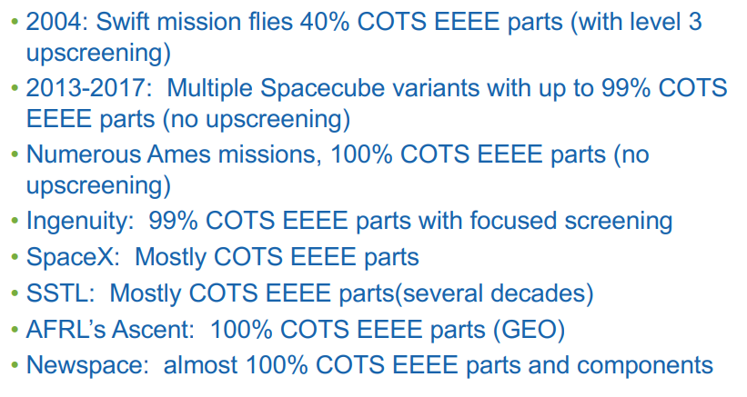
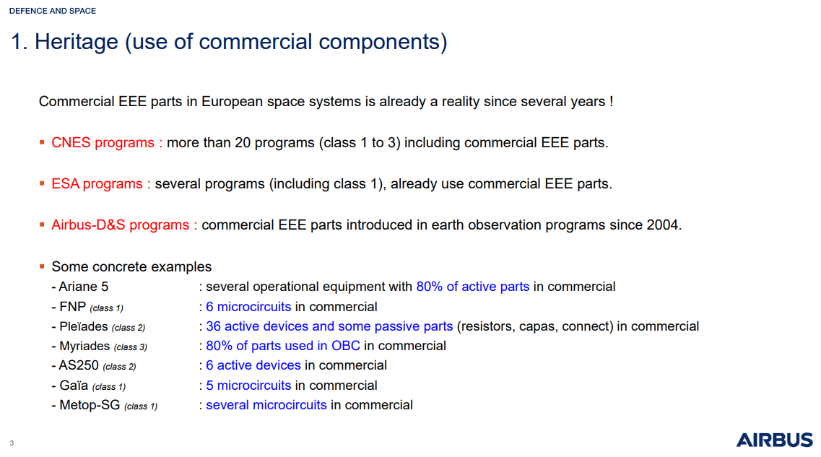
Governmental agencies also embracing COTS components
NASA Report, 2021
"Upscreening" is performing the tests that are not performed in the automotive manufacturing process. Why no upscreening?

Slide 8
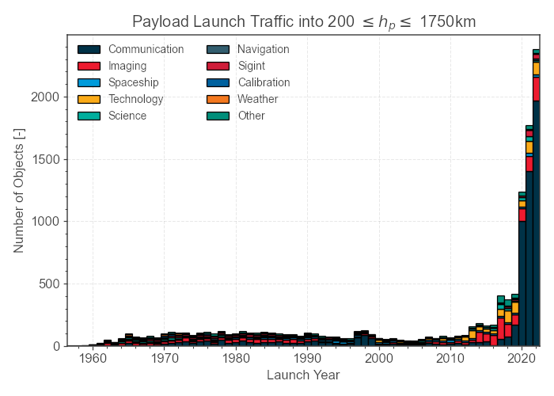
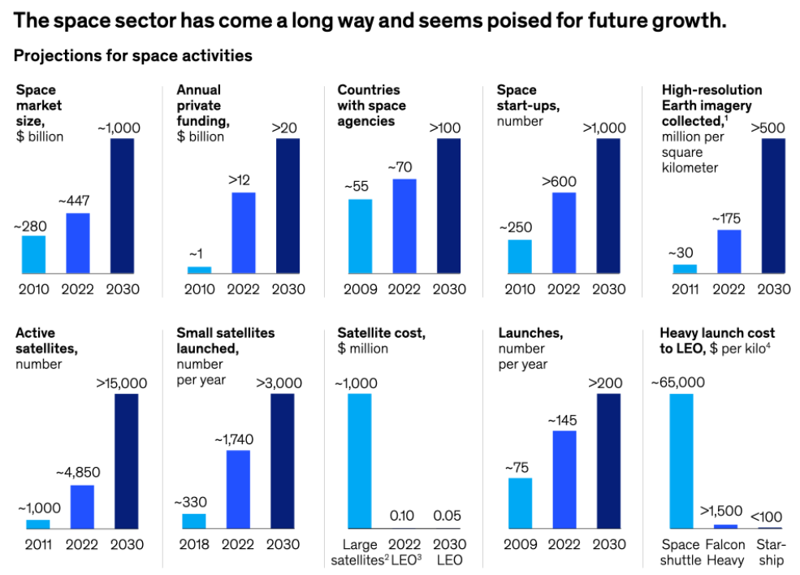
Evolution of the Space Market
New Space is a trillion-dollar market driven by private funding. The main use cases are communication, navigation and imaging. Satellites could be produced at 1/1000 of the price due to COTS components.
Source: McKinsey & Co. , 2022

Slide 9
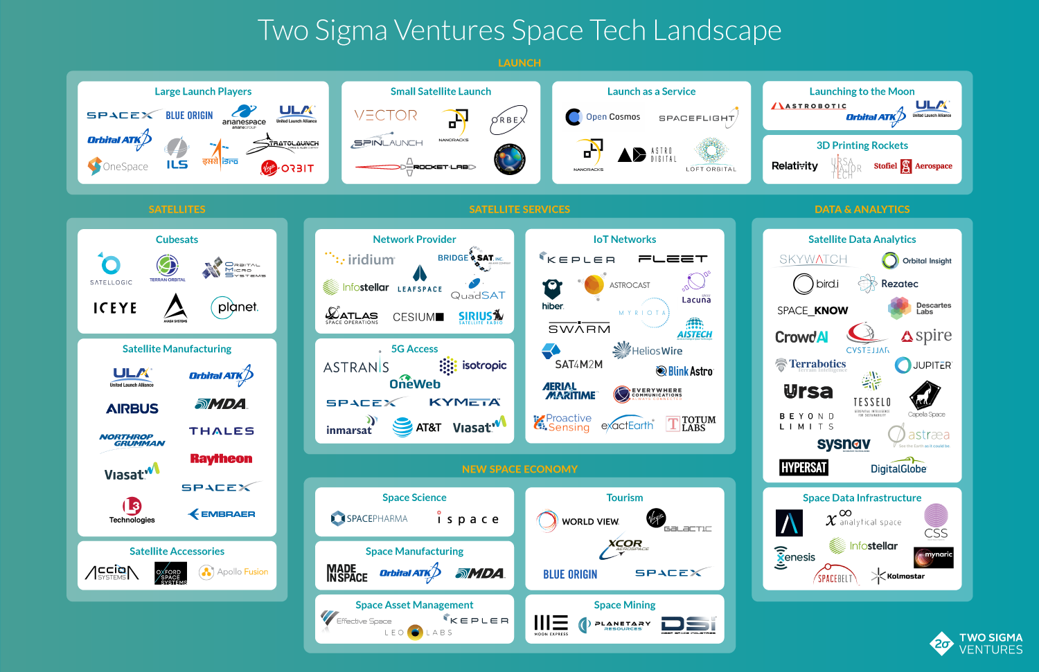

Slide 10
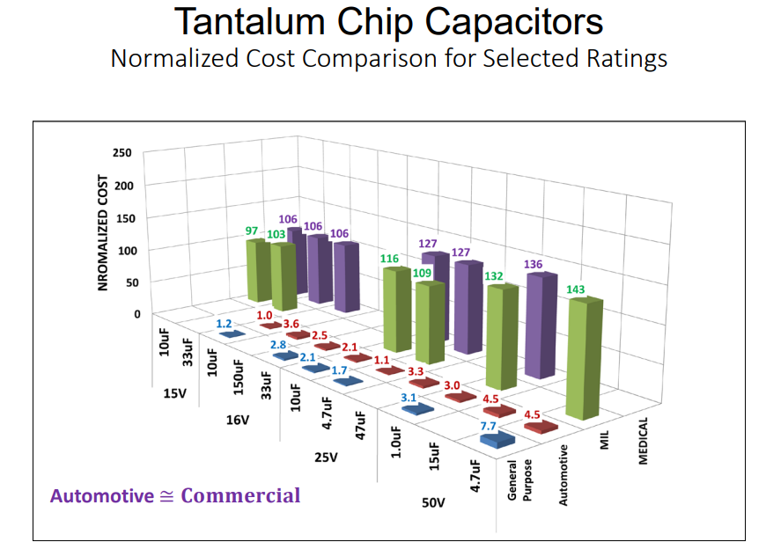
The case for using COTS components
Automotive COTS are a popular choice because they are cheap, but are tightly regulated and extensively tested.
IATF - Standardize assessment and production methodologies
AEC-Q: Stress testing for Automotive conditions (harsh)
PPAP: complete documentation from design, testing, failure control to statistical analysis(SPC).
Commercial: phones, laptops
Automotive: cars, trucks
Military, satellites, aircrafts, missile guidance
Medical: imaging, equipment

Slide 11
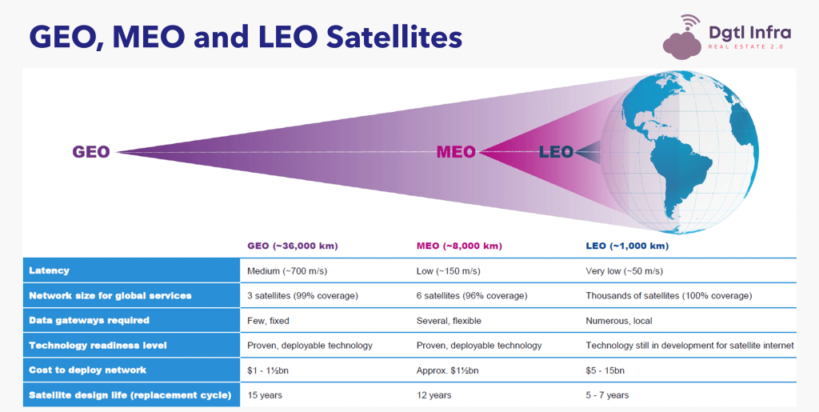
Manned Rockets to Unmanned Satellites, New Space dominating LEO
New Space use cases mostly concern Lower Earth Orbit (LEO):
- SpaceX travel around LEO
- Satellites have better communication in lower orbit, easier to launch, cheaper.
Most New Space start ups offer service around launch and reusability while Trad Space still builds the complexer rockets.

Slide 12
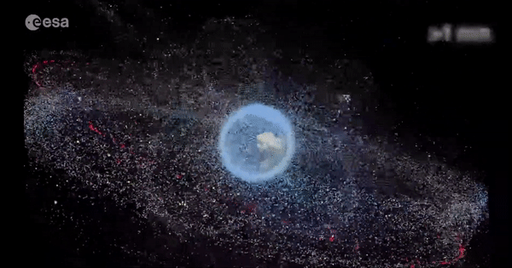
Space Debris - Does New Space have a future?
The future of Space is in connecting other industries like science, agriculture and automotive, collecting data to be applied in AI models for many day to day decisions.
Debris is generated through explosions of unsuccessful missions, deliberate anti-satellite missile testing, or simply lack of clean up after end of life. Debris may orbit for decades or centuries given the lack of atmospheric drag slowing the speed. Lastly, debris enlarges the ozone hole.
SpaceX launches alone have doubled the number of LEO orbiting satellites and even though the Kessler effect is not proven to have began, the Space industry must "clean up its act".
Kessler Effect - Collisions cause remnants to explode outwards at high speed, causing further chain explosions.
Launches will also be increasingly difficult once collision occurrence and debris density reaches higher levels

Slide 13
SCM - Space vs Automotive
COTS in Space

Slide 14
Definitions
EEE Component - device which performs an electronic, electrical or electromechanical function and consists of one or more elements joined together and which cannot normally be disassembled without destruction (ECSS-Q-ST-70-08C)
Commercial-of-the-Shelf (COTS) - commercial electronic component readily available off-the-shelf, and not manufactured, inspected or tested in accordance with military or space standards (ECSS-E-ST-10-12C)
Qualified Parts List (QPL) - a list of components and technologies which have been, respectively, qualified and capability approved to the rules of the ESCC Specification System and the results certified by ESA.
European Preferred Parts List (EPPL) - a list which aims to support the selection of components for the European space community, giving preference, whenever possible, to European suppliers, reducing the number of types and proposing a standardisation of the ranges of values for passive parts. It is NOT a qualified list and the QPL is preferred in cases of conflict.

Slide 15

Who regulates components?
The European Cooperation for Space Standardization (ECSS) is an initiative established to develop a coherent, single set of user-friendly standards for use in all European space activities.

Slide 16
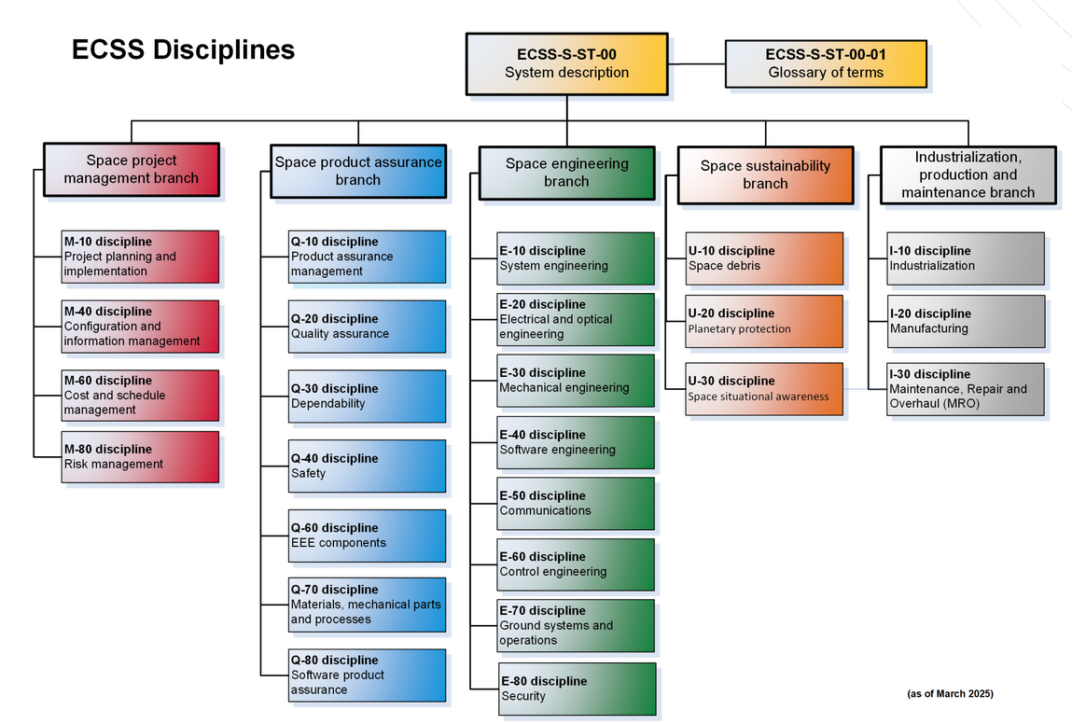

Slide 17

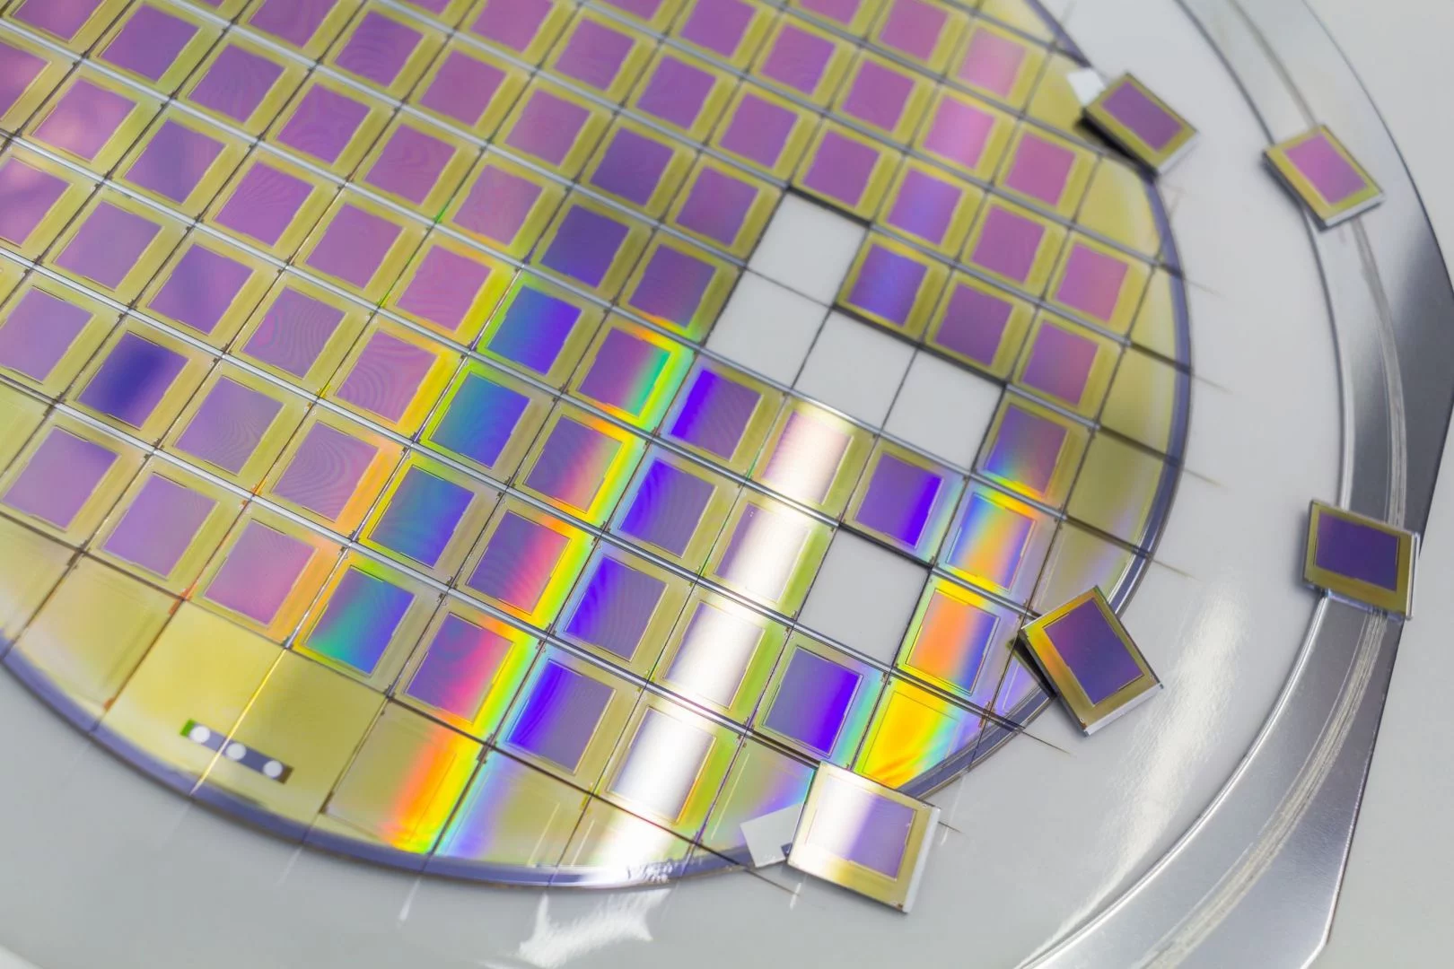


SCM for Classical Space - Manufacturers
Order is placed by Space customer.
Thorough electrical testing before encapsulation.
A buyoff inspection from the Space agency before shipment.
Component is encapsulated.
Further radiation, environment and electrical tests carried out.
Some tests, like 1000h burn in, requires months to complete, causing a long mission schedule.
Process
Foundries have contracts with mines to source Si, GaN and other semiconductive metals.
Wafers are radiation tested and the circuit internals are imprinted through a variety of methods - doping, etching, photolithography
An inspection is performed by a representative of the Space agency.
Documentation
RoHS - Restriction of Hazardous Substances used in electronics. Must meet reqs to supply to EU.
Conflict minerals compliance
Certificate of Conformance is compiled with all testing data.
Shipped according to safe transport and storage policies.
Wafers are assigned a wafer number, Fab ID.
Radiation testing results recorded.
Lot number and date code assigned.
Further radiation, environment and electrical tests carried out.
Notes:
Inspections are expensive due to cost of training from agency and agencies have to pay a fee to manufacturers to make their production lines open for a day.

Slide 18
Project Management
Identify the parties and define a organizational structure responsible for efficient management of the project and selection, procurement and control of components.
Establish Parts Control Board (PCB)
Comprised of supplier and customer representatives and any subcontractors. Include relevant technical experts and parts engineers.
Define controls and approvals for the whole procurement process.
Manage non conformities which may arise
Create Components Control Plan
A plan to meet project objectives, manage budget and assure quality of components
Consists of the entire procurement cycle operations and relevant documentation and reports
Declared Components List (DCL)
A digital and editable list of components which need to be procured.
In the case of COTS, a JD is sufficient
The supplier of components is almost never the direct manufacturer in COTS procurement

Slide 19
Part Evaluation and Selection
Components must meet budget, design and schedule requirements. Functionally, they must achieve defined operational capabilities as well as conform to specific manufacturing processes (mounting, thermal, encapsulation, etc).
Manufacturer and component selection
Main supplier must manage conformity of sub contractors.
Check for restricted parts and materials (eg. raw materials, bonding, encapsulation)
Perform risk analysis
Component selection
Evaluation of component against common tests
Possible evaluation of the manufacturer / supplier.
Constructional Analysis (CA)
Parts approval
Must maintain a traceable record of acceptance and approval of each component
Parts Approval Document (PAD) for Space Grade components
Justification Dossier (JD) for EEE components

Slide 20
Part Procurement
Suppliers of space components are responsible for ensuring the manufacturer conformance as well as compliance to specified inspections, screening and tests.
Procurement specification
Suppliers must strictly procure according to the defined specification.
Any new specification must go through approval of the customer.
Screening
Definition of series of test for thermal, electrical and physical standards of the component.
Test will be carried out by the manufacturer
Inspections
Performed by supplier at manufacturer site. Additional man hours for manufacturer and a financial cost for supplier.
Precap: Audit of component before encapsulation
Lot acceptance: After encapsulation, when Lot is serialized with ID
Buy-Off: final inspection before shipping to supplier
Incoming Inspection: First inspection at supplier site after components are delivered.

Slide 21
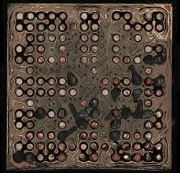

Part Testing
Tests are performed per lot. The number of samples increase with COTS components.
Radiation testing
Overall TID (total ionising dose) testing as well as SEE (single dose) testing
Incredibly expensive and hard to secure test chambers
Destructive Physical Analysis (DPA)
Test which end in the physical destruction of the component
Must be calculated into procurement quantity
Relifing
Ensure longevity of stored components
Must ensure there are no PCNs or alerts with associated date code when using the component

Slide 22

SCM for Automotive
Automotive companies review several PPAPs and select the best one
Small orders may only be made through distributors.
Process
Manufacturers produce the component in the magnitude of millions.
Current statistical methods ensure failure rates of under 10 ppm!
Manufacturers source raw materials from foundries
Produce a sample of the component
Production process, failure management, test certifications and statistical control methods recorded in PPAP.
PPAP
RoHS or other certification
Lot number and week code is combined into a trace code. Not unique!
All tests carried out on a reel is detailed in the PPAP.
A Datasheet is available publicly or requires an additional payment.
Notes:
Inspections are expensive due to cost of training from agency and agencies have to pay a fee to manufacturers to make their production lines open for a day.

Slide 23
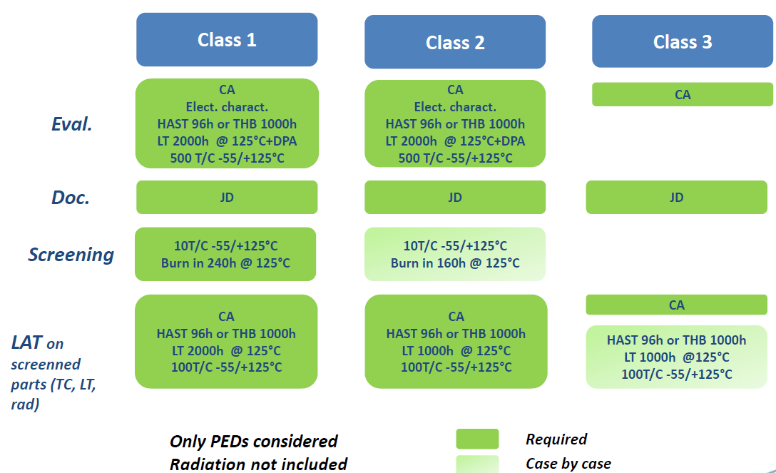
ECSS-Q-ST-60-13C: Gold standard of COTS
A tradeoff between risk and assurance.
Class 1 offers lowest risk and highest assurance while Class 3 is high risk and low assurance.
Sliding scale of component evaluation, required documentation, screening methodologies and testing practices
No radiation? Woah!
Notes:
ESA mission classes. 1 is critical GEO missions (more description)

